Slide 1

DELIVER AMAZING RESULTS WITH SHAREPOINT
SITE DESIGNS
ERIC OVERFIELD | PixelMill
Microsoft MVP & RD
SharePoint Advocate & Enthusiast
@ericoverfield
http://pxml.ly/EO-Site-Designs-Oct2018
Notes:
https://unsplash.com/photos/VkwRmha1_tI

Slide 2


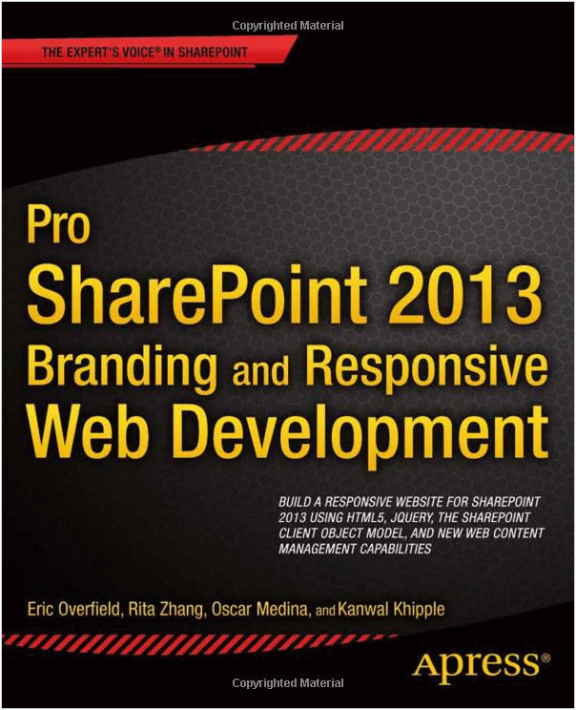
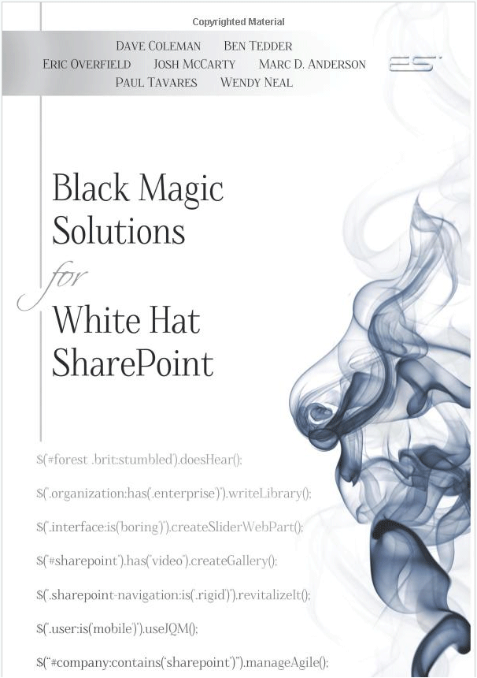


ERIC OVERFIELD
President & Co-Founder of PixelMill
Microsoft Regional Director
Microsoft MVP, Office Apps & Services
Microsoft MVP, Office Development
Technology Community Organizer & Contributor
ericoverfield.com
@ericoverfield

Slide 3

PIXELMILL
PixelMill is a digital workplace design agency based in Northern California. On the forefront of web design trends since 1998, PixelMill provides innovative collaboration and communication portals and solutions for Office 365, SharePoint, and Azure.
pixelmill.com
@pixelmillteam

Slide 4
OVERVIEW
SharePoint Online Site Creation Process
Site Designs
Site Scripts
Advanced Techniques and Provisioning Accelerators

Slide 5
SHAREPOINT ONLINE SITE CREATION AND BRANDING PRINCIPLES
Super fast creation process
Browser based experience
Extendable – UI and in code
Based on branding principles
Professional
Railed experience
Efficient & smart
Accessible

Slide 6
SITE DESIGNS POWERED BY SITE SCRIPTS
Automate consistent custom provisioning = modern “site templating”
Utilize Site Designs and Site Scripts within the SharePoint experience
Flexible site configuration model – enabling clean & consistently branded sites
Recreate and configure SharePoint objects, apply site settings, and call custom solutions
Apply branding and pre-provisioned assets at time of site creation
Set site settings and call custom processes with Microsoft Flow
Driven by json configuration files
Set up via REST, CSOM, or PowerShell*
Latest features
Apply site designs when joining a hub (soon)
Export artifacts to site scripts (lists)
Register SPFx extensions
Notes:
SharePoint Online Management Shell, as a tenant admin
Can also use PnP Provisioning to provision site designs and site scripts
When to use site designs
new site creation
update existing / classic sites in limited fashion
update existing sites with common site elements / changes
configure sites associated to hub

Slide 7
SITE DESIGN ENABLED PROVISIONING PROCESS
Available Site Designs appear in SharePoint site creation process
1
3
Apply site designs
2
During site creation process, selected site design applies registered site scripts
Site Scripts are executed in order and process is displayed in progress panel
Notes:
Inspiration
https://www.slideshare.net/SharePointPnP/pnp-webcast-introduction-to-sharepoint-site-designs-and-site-scripts step 4

Slide 8
MODERN PROVISIONING CORE COMPONENTS:
SITE DESIGNS AND SITE SCRIPTS

Slide 9
ANATOMY OF A SITE DESIGN
Collection of metadata that describes an available site design
Configured with PowerShell, CSOM, or REST API
Each site design may include:
Title, Description
Web Template – 64 = modern team – 68 = communication
Array of Site Scripts
Site designs may be scoped to specific users / groups
A site design may also be registered as a default site design*
Site designs may be updated then re-applied to existing sites
Notes:
Site designers are like modern site templates
set a site design as default - thus applied to all comm or team sites
get around some limitations of site creation processes throughout O365

Slide 10
ANATOMY OF A SITE SCRIPT
JSON based array of “actions” – each action consists of a “verb” and its properties
Script actions can be concatenated to singe file or multiple files can used
Current limit of 30 cumulative actions across one or more site scripts, including sub actions
Long site scripts may be queued with new commandlet: Add-SPOSiteDesignTask
Notes:
Inspiration
https://www.slideshare.net/SharePointPnP/pnp-webcast-introduction-to-sharepoint-site-designs-and-site-scripts step 5
Each site script may be up to 20k characters long
Add-SPOSiteDesignTask to execute large site script up to 100k characters
replacement for Invoke-spositedesign

Slide 11
AVAILABLE SCRIPT ACTIONS
Currently available script actions - verbs
Creating a new list or library (or modifying the default one created with the site)
Creating site columns, content types, and configuring other list settings
Applying a theme
Setting a site logo
Add and remove navigation
Join a hub site
Triggering a Microsoft Flow
Installing a deployed solution from the app catalog
Register a SPFX extension
Setting regional settings for the site
Setting external sharing capability for the site
Add users (principal) to SharePoint Groups / manage guest access
https://docs.microsoft.com/en-us/sharepoint/dev/declarative-customization/site-design-json-schema
More actions are expected
Notes:
https://docs.microsoft.com/en-us/sharepoint/dev/declarative-customization/site-design-overview

Slide 12



SITE SCRIPT ACTION BREAKDOWN
SharePoint Components
createSPList
addSPField
deleteSPField
addSPFieldXml
createSiteColumn
createSiteColumnXml
addSiteColumn
addContentType
createContentType
removeContentType
addSPView
removeSPView
setSPFieldCustomFormatter
Settings
addPrincipalToSPGroup
addNavLink
removeNavLink
applyTheme
setSiteLogo
setRegionalSettings
setSiteExternalSharingCapability
triggerFlow
joinHubSite
Branding & Other Site Settings
SharePoint
Components
Register Solutions:
installSolution
SPFx Extension support!
associateExtension
associateListViewCommandSet
associateFieldCustomizer
Apps & Solutions
Source: https://myignite.techcommunity.microsoft.com/sessions/65682
Notes:
https://myignite.techcommunity.microsoft.com/sessions/65682#ignite-html-anchor

Slide 13
BUILDING:
SITE DESIGNS AND SITE SCRIPTS

Slide 14

ADD SITE SCRIPT WITH POWERSHELL
Using SharePoint Online Management Shell to work with Site Scripts
$cred = Get-Credential Connect-SPOService $adminSiteUrl -Credential $cred
Get available site scripts
Get-SPOSiteScript [-Identity]
Add a site script
$siteScript = Add-SPOSiteScript -Title $scriptTitle -Content $siteScriptJson -Description $scriptDescription
Update a site script
Set-SPOSiteScript -Identity $siteScript.Id -Content $newSiteScriptJson
Remove a site script
Remove-SPOSiteScript -Identity $siteScript.Id
Additional commandlet parameters exist, review docs.microsoft.com
Suggestion – install SPO Management Shell direct from PowerShell Gallery
https://www.powershellgallery.com/packages/Microsoft.Online.SharePoint.PowerShell
Notes:
https://docs.microsoft.com/en-us/sharepoint/dev/declarative-customization/site-design-overview
Site scripts should come first, as a site design requires at least one site script
Can still use CSOM and Rest API as well.
I have found module from PS Gallery most up to date

Slide 15
CREATE A SITE SCRIPT WITH POWERSHELL
Notes:
Basic commands
Connect to SPO
Get existing site scripts
Add site script

Slide 16
USING POWERSHELL TO ADD SITE DESIGNS
Use SharePoint Online Management Shell to work with Site Designs
$cred = Get-Credential Connect-SPOService $adminSiteUrl -Credential $cred
Get available site designs
Get-SPOSiteDesign [-Identity]
Add a site design
$siteDesign = Add-SPOSiteDesign $title -WebTemplate $webTemplate -SiteScripts $siteScript.Id -Description $description -PreviewImageUrl $previewImageUrl
Update or remove a site design
Set-SPOSiteDesign -Identity $siteDesign.Id -SiteScripts $newSiteScript.Id Remove-SPOSiteDesign -Identity $siteDesign.Id
Apply a site design to an existing site, including classic sites (limited verbs)
Invoke-SPOSiteDesign -Identity $siteDesign.Id
REST API endpoint for Site Designs and Site Scripts
/_api/Microsoft.Sharepoint.Utilities.WebTemplateExtensions.SiteScriptUtility
Notes:
For classic sites, verbs such as set theme, create link

Slide 17
CREATE A SITE DESIGN WITH POWERSHELL
Notes:
Basic commands
Connect to SPO
Get existing site designs
Add site design
Get site design

Slide 18



EXTEND SITE DESIGNS WITH MICROSOFT FLOW
Use Script Action verb “triggerFlow” to extend Site Designs
Possible Flow includes executing an Azure Function
Combine Site Designs with PnP Provisioning Engine
Notes:
https://docs.microsoft.com/en-us/sharepoint/dev/declarative-customization/site-design-overview#using-powershell-or-rest-to-work-with-site-designs-and-site-scripts
Flow to trigger azure function
https://docs.microsoft.com/en-us/sharepoint/dev/declarative-customization/site-design-pnp-provisioning

Slide 19
COMMON SITE DESIGN EXTENSIBILITY PROCESS
Notes:
Source: https://image.slidesharecdn.com/pnpwebcast-introductiontositedesigns-180122085801/95/pnp-webcast-introduction-to-sharepoint-site-designs-and-site-scripts-7-638.jpg?cb=1516611728

Slide 20
SITE DESIGNS AND SITE SCRIPTS
IN CONCERT TOGETHER
Notes:
Create a new site that uses a site design
Watch actions
trigger flow as well

Slide 21
SITE DESIGNS VS / WITH PNP PROVISIONING
Site Designs
SharePoint native site creation process
Allow creation of new sites natively within SharePoint using browser
Limited script action verbs and number of concurrent actions
Extend using Microsoft Flow and external process / PnP Provisioning
PnP Provisioning
Based on community effort external to SharePoint / open source
Requires custom app, a triggering process, PowerShell, etc
Currently many more options / actions
Page creation, Site Design activation, etc
Conclusion = Better together!

Slide 22
SITE DESIGN STUDIO
BRINGING SITE DESIGNS TO THE MASSES

Slide 23
SITE DESIGN STUDIO – BROWSER BASED SITE DESIGN MANAGEMENT
Site Design Studio
Open source SPFx Site Design management solution
Project lead: Yannick Plenevaux (GitHub: @ypcode) (Twitter: @yp_code)
Uses SharePoint REST API / Site Script endpoints
Based on a SPFx webpart
Add to an admin site collection
Does require SharePoint tenant / administrative access
Other GUI’s exist!
https://www.sitedesigner.io/#/

Slide 24
SITE DESIGN STUDIO
Notes:
https://github.com/SharePoint/sp-dev-solutions/tree/master/solutions/SiteDesignsStudio
https://www.sitedesigner.io/
Review studio
Check out demo site
Add site script
Add site design that uses site script
Add site using new site design

Slide 25
SITE DESIGNS – FINAL THOUGHTS
Control user / group access to Site Designs with Grant-SPOSiteDesignRights and Revoke-SPOSiteDesignRights commandlets
Use "IsDefault" parameter when adding/modifying site design to make it used by all site designs
Site Designs may be activated programatically as well, such as Invoke-SPOSiteDesign – applied a site design to an existing site Add-SPOSiteDesignTask – queue a site design task, site script <= 100k chars
Site script – auto generation evolving – generate list and library site scripts* $list = Get-SPOSiteScriptFromList -ListUrl "{listurl}"
When using the Communication WebTemplate, "Topic" site design is the base
Notes:
site scripts - auto-generation – currently experimental
New option to generate lists and library site scripts from existing
$list = Get-SPOSIteSCriptFromList -ListUrl "{listurl}"

Slide 26
REVIEW
SharePoint Online Site Creation
Site Designs
Site Scripts
Advanced Techniques and Provisioning Accelerators

Slide 27
RESOURCES

Slide 28
RESOURCES
Site Design Overview http://aka.ms/spsitedesigns
Site Script JSON Schema https://docs.microsoft.com/en-us/sharepoint/dev/declarative-customization/site-design-json-schema
Site Script examples http://aka.ms/spsitescriptsamples
Site Design Studio https://github.com/SharePoint/sp-dev-solutions/tree/master/solutions/SiteDesignsStudio
Customizing default site designs https://docs.microsoft.com/en-us/sharepoint/dev/declarative-customization/customize-default-site-design

Slide 29
DELIVER AMAZING RESULTS WITH SHAREPOINT
SITE DESIGNS
THANK YOU

